Slide 1
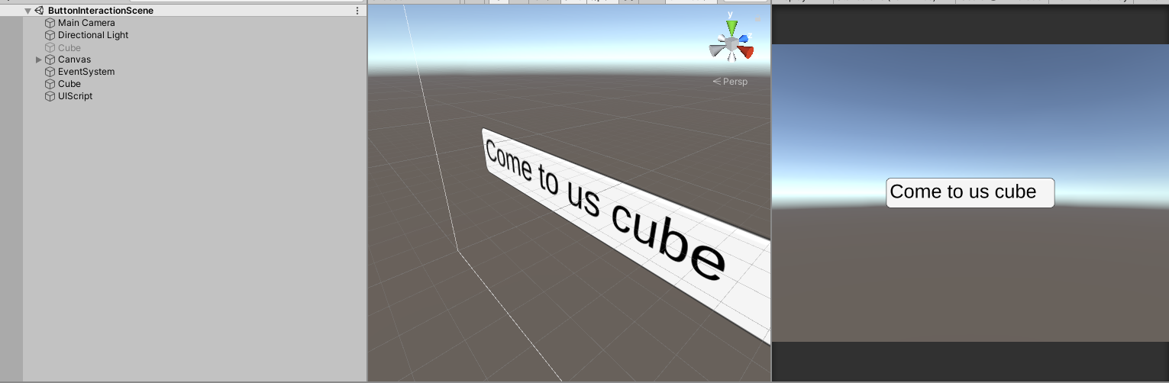
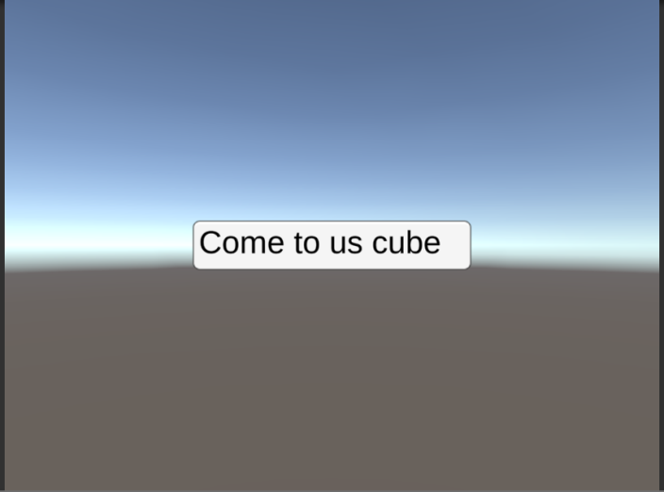
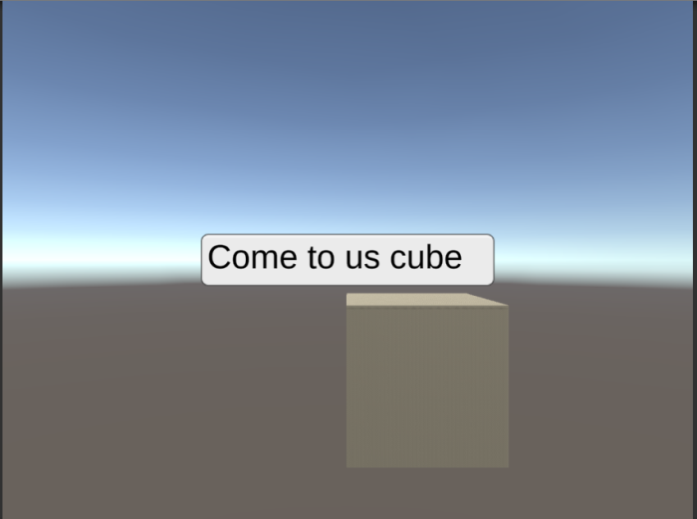
Scene
This is the scene in Unity that I have made to test the function the plan is to have it so that when you click on the button a box will appear on the bottom right

Slide 2
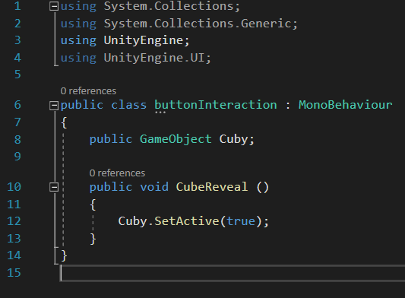
Interactive Button Script
I first off start with letting Unity know that I am using the UI with “using UnityEngine.UI”
I then make a reference to a game object, the cube that is to appear after the button is clicked called “Cuby” in the scene
I then create a custom void that is public so I can reference it outside of this script when needed
I then set the command to make the cube to true as it is currently set to false within the scene itself

Slide 3

Final adjustments made in Unity
I then add the script as a function for the button upon being clicked

